Slide 1
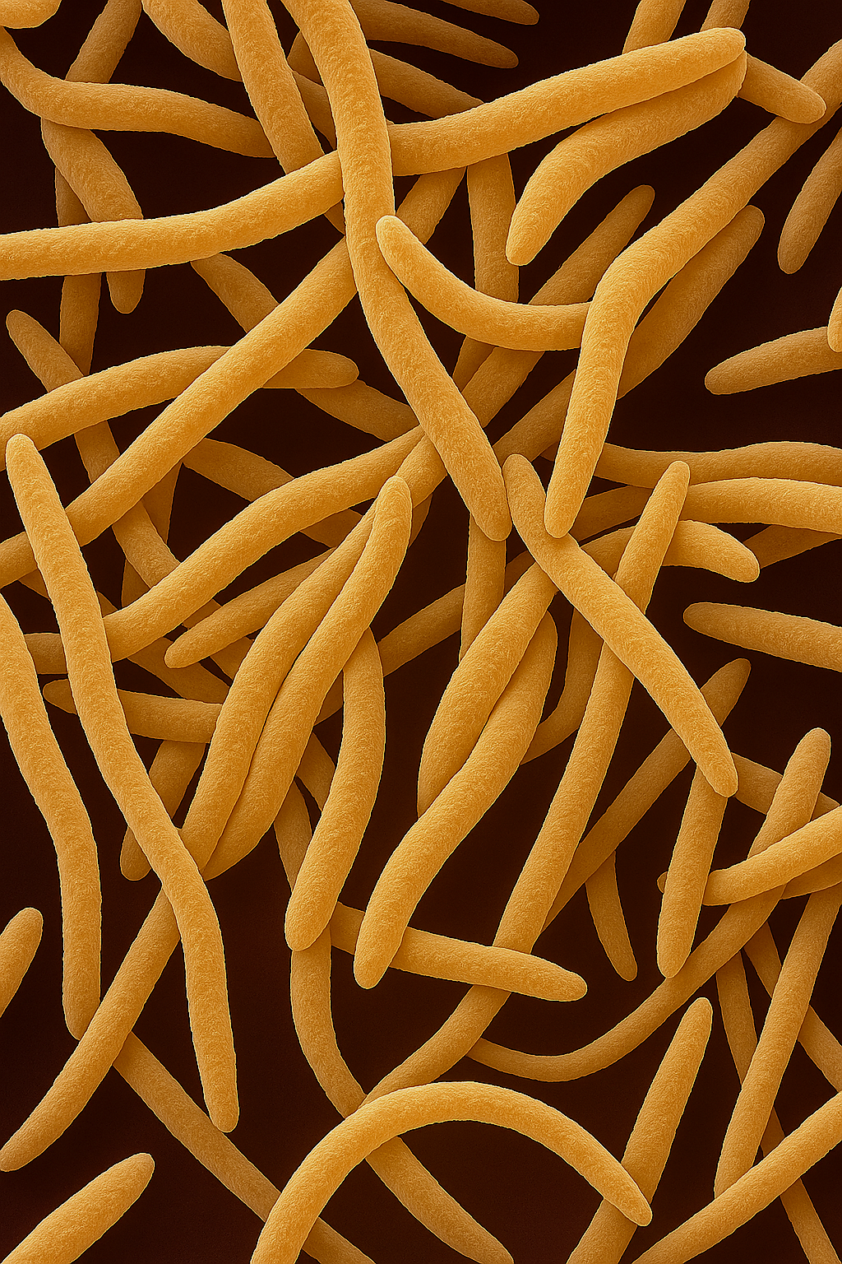
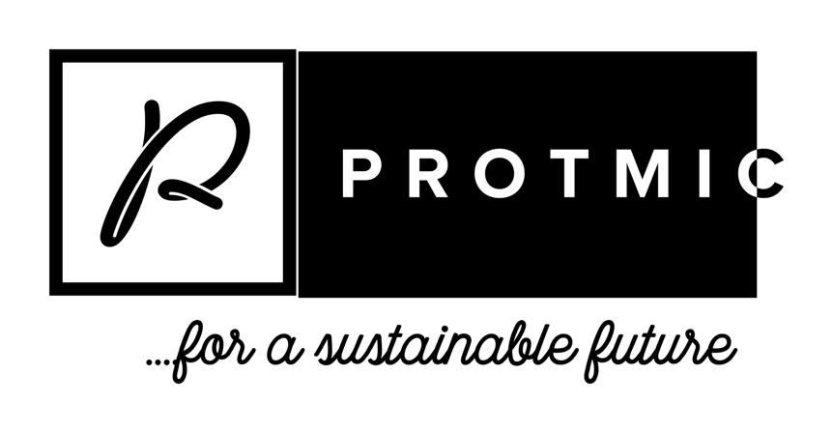


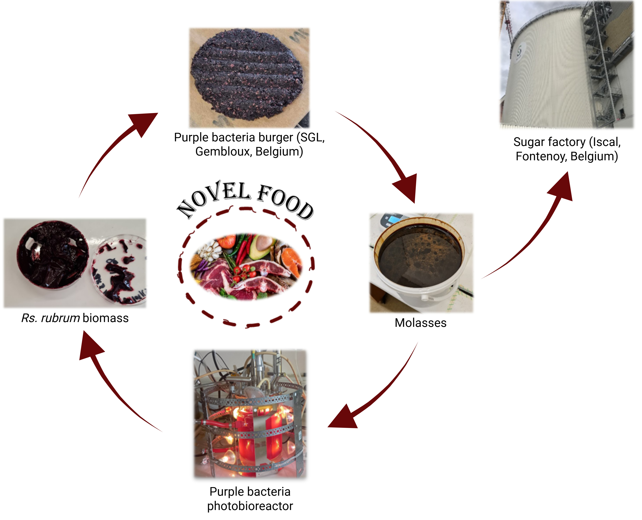
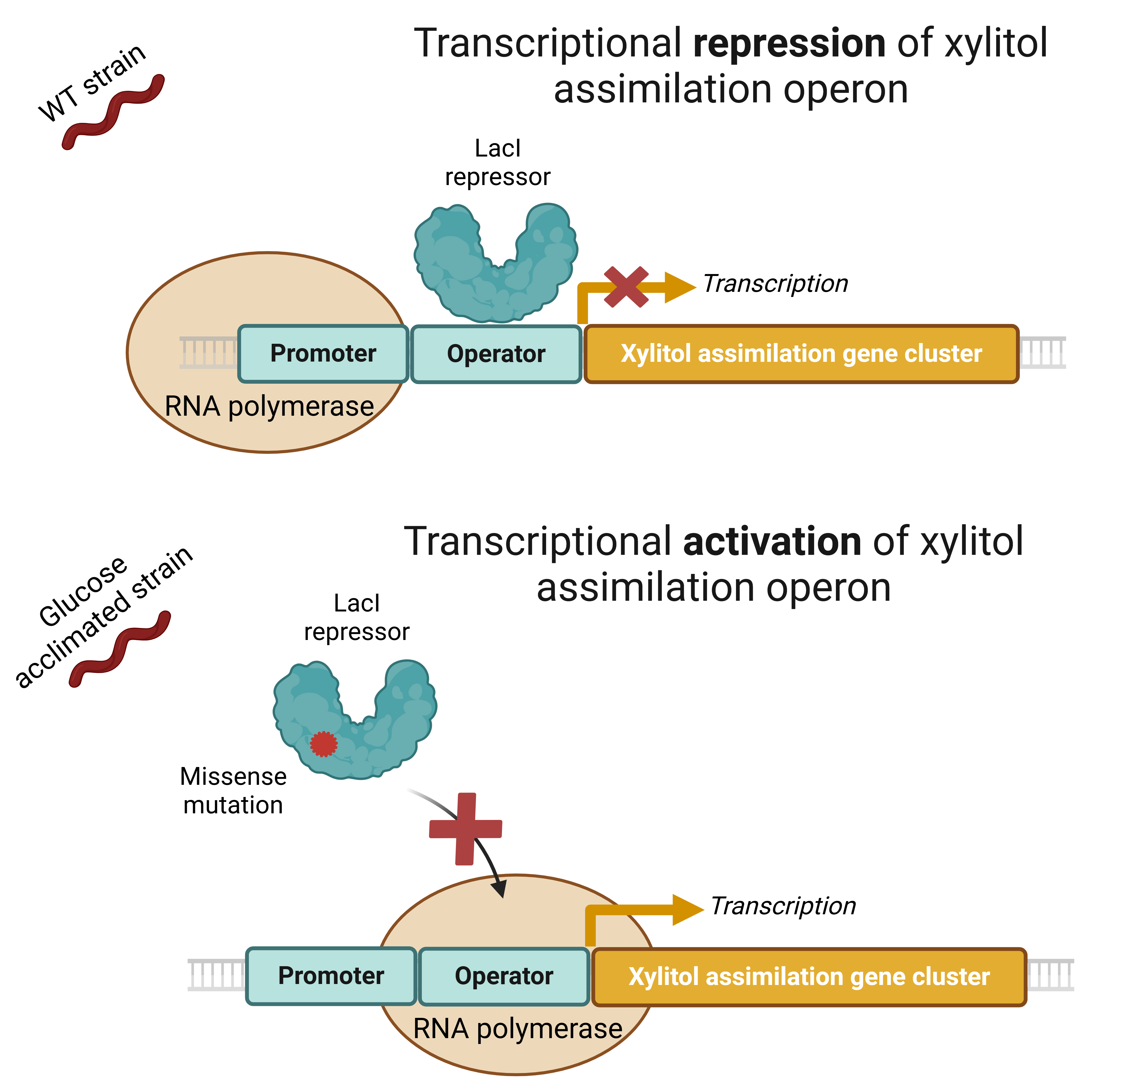
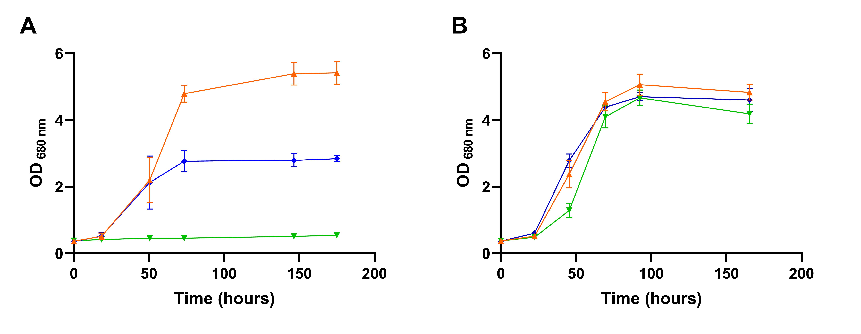



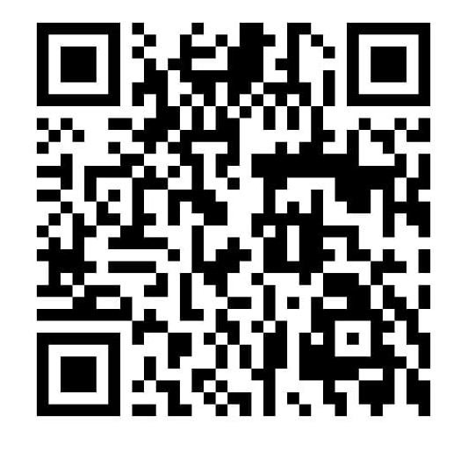

Assimilation of sucrose and its derivates by Rhodospirillum rubrum and Rhodobacter capsulatus
Manon Gilson, Guillaume Bayon-Vicente, Ruddy Wattiez, Baptiste Leroy
Proteomics and Microbiology Laboratory, 7000 Mons, Belgium
Presented as part of a scientific stay in Prof. McKinlay’s laboratory, Indiana University Bloomington
Introduction
Global demand for protein has enormously increased in recent years, mainly due to the increase in the world's population and changing diets. This increase in protein demand has a major economic and ecological impact (e.g., importation, deforestation, eutrophication, ...). It is therefore essential to develop new sources of protein that have a lower environmental impact. Nowadays, the production of high-quality microbial protein as a meat substitute and from by-products of the agri-food industries (e.g. molasses) is being explored. In this context, purple non-sulfur bacteria (PNSB) show considerable advantages. Indeed, their remarkable metabolic versatility makes them capable of converting multiple carbon sources into protein rich biomass.
Figure 1 : Circular bioeconomy based on non-sulfur purple bacteria and co-products from agri-food industries
Trophic link between two purple non-sulfur bacteria
Figure 3 : Monitoring of growth (blue line) of co-cultures Rs. rubrum/Rh. capsulatus grown in a sucrose-containing medium, sterilized through filtration. Red, green and orange lines represent the evolution of sucrose, glucose and fructose concentration, respectively. Bar plots represent the proportions of Rs. rubrum (black bars) and Rh. capsulatus (hatched bars) at different time points. N = 5. Results are represented as the mean ± SD.
Rs. rubrum was unable to use sucrose and assimilated fructose and glucose sequentially (Figure 2A), with glucose uptake being significantly slower. In contrast, Rh. capsulatus could hydrolyze sucrose and assimilated sugars incompletely.
Figure 2 : Monitoring of growth (blue line) of Rhodospirillum rubrum (A) and Rhodobacter capsulatus (B) cultivated in a sucrose-containing medium, sterilized through autoclave (B). Red, green and orange lines represent the evolution of sucrose, glucose and fructose concentration, respectively. N = 5. Results are represented as the mean ± SD.
When co-cultured, the two strains showed synergistic interactions, resulting in complete sugar assimilation and enhanced productivity (Figure 3). Interestingly, Rs. rubrum remained in the culture despite sucrose being the only carbon source. Proteomic and medium composition analyses revealed a trophic interaction: Rh. capsulatus ferments sucrose into organic acids, which are subsequently consumed by Rs. rubrum.
Development of a glucose-acclimated Rhodospirillum rubrum strain
In order to select for glucose assimilation capacity, we exposed Rs. rubrum to a medium containing only glucose as carbon source for two months. While the wild-type strain showed no growth on glucose (Figure 4A), the adapted strain, after this period, assimilated glucose as efficiently as fructose (Figure 4B). Genomic and proteomic analyses revealed the involvement of a xylitol assimilation gene cluster, with higher protein abundance in the acclimated strain. Two mutations were found in this cluster, including one in a LacI-type regulator. We hypothesize that this mutation prevents repression of the cluster, leading to constitutive expression of the xylitol assimilation gene cluster, thus enabling glucose assimilation (Figure 5).
Figure 4 : Monitoring of growth of Rs. rubrum WT (A) or the glucose-acclimated strain (B) in a medium containing fructose (orange line), glucose (green line) or a mix of fructose and glucose (blue line) as carbon sources. N = 3. Results are represented as the mean ± SD.
Figure 5 : Hypothesis that the missense mutation in the LacI gene causes the interruption of the transcriptional repression of the gene cluster in the MG strain.
Take-home message
The two strains of PNSB tested here showed different behaviours in the presence of sucrose and its derivatives. While Rs. rubrum is unable to assimilate sucrose, Rh. capsulatus is able to hydrolyse it. Co-cultures showed an enhanced productivity compared to pure cultures. Besides pure cultures, co-cultures are of great interest for industrial applications because of their synergic effect. Additionally, a glucose-acclimated strain of Rs. rubrum was developed, now exhibiting a glucose assimilation rate similar to that of fructose.
References : Bayon-Vicente, G. et al. Metabolic pathways to sustainability: Review of purple non-sulfur bacteria potential in agri-food waste valorization. Front. Bioeng. Biotechnol. 13, 1–24 (2025). Gibson, M. S. & Wang, C. H. Utilization of fructose and glutamate by Rhodospirillum rubrum. Can. J. Microbiol. 14 (1968).
Acknowledgement : This work was financed by the SPW-EER (Wallonia recovery plan – Win4Excellence, FoodWal agreement N°2210182). Proteomic data acquisition was made possible through the support of the European fund for regional development (FEDER) through the Bioprofiling platform (Prof. R. Wattiez) co-financed by EU and Wallonia. I would like to thank Prof. McKinlay and his team for their kind welcome and support during my ongoing research stay.
Presenting author: manon.gilson@umons.ac.be & Corresponding author: Baptiste.Leroy@umons.ac.be

